Slide 1
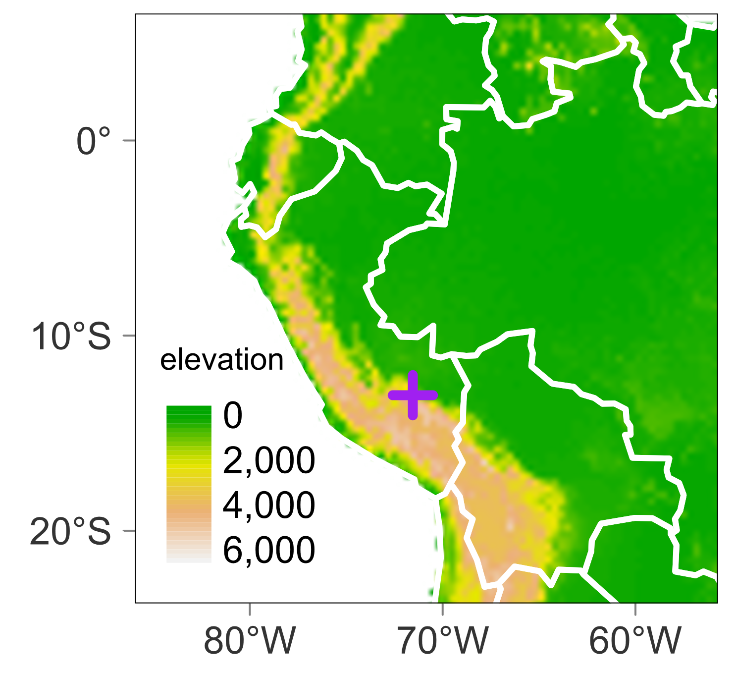
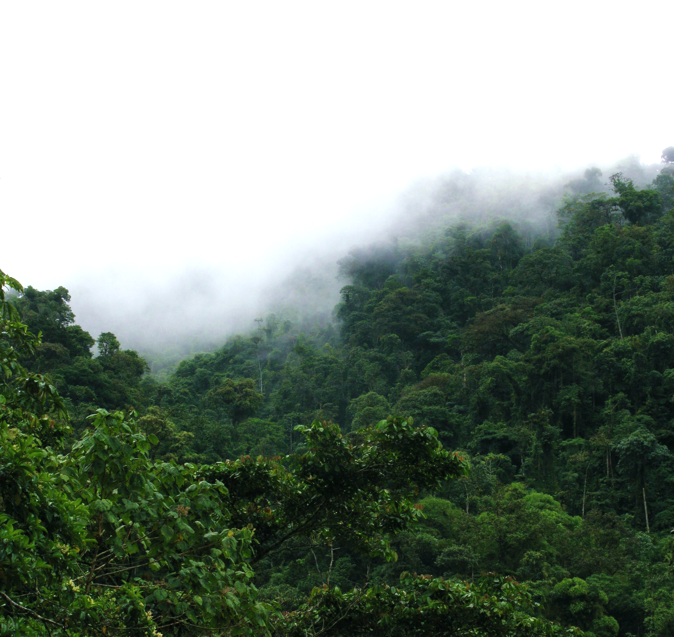
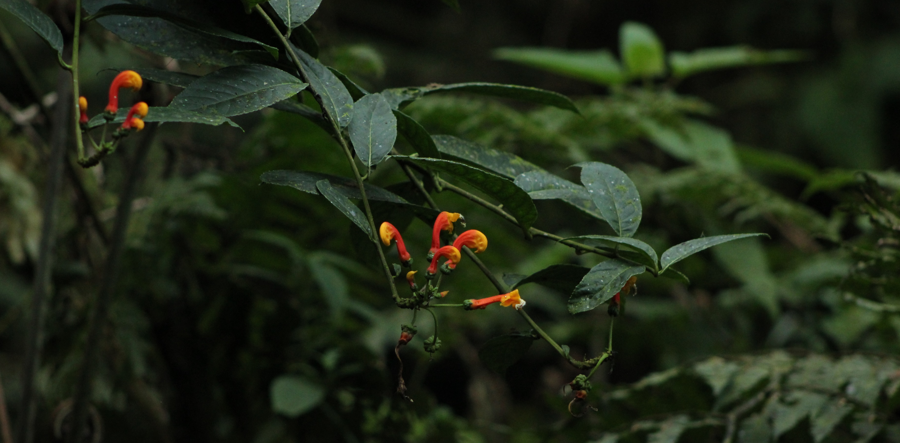
A
B
C

Slide 2
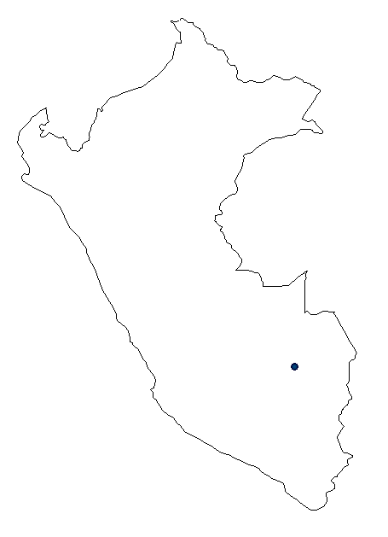
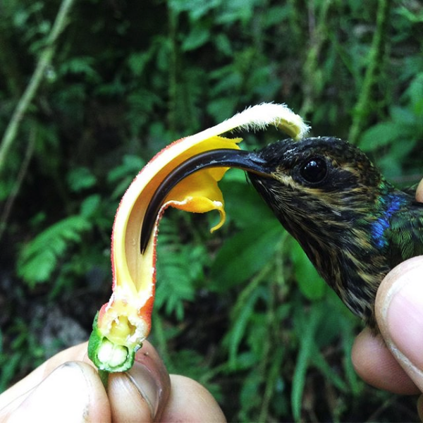
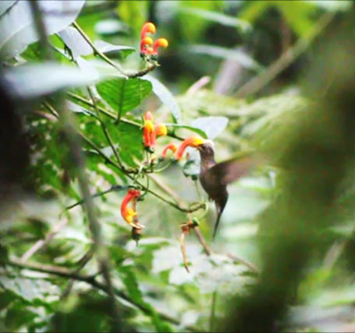
A
B
-13.05, -71.55
C
D

Slide 3
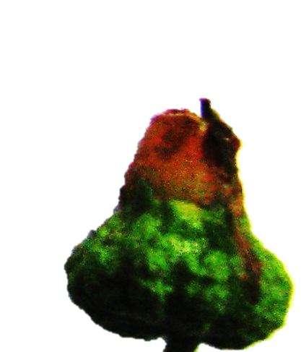
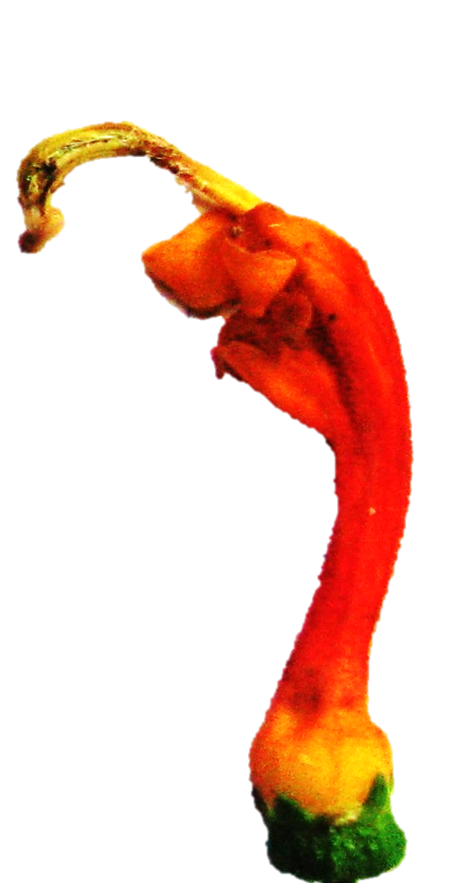
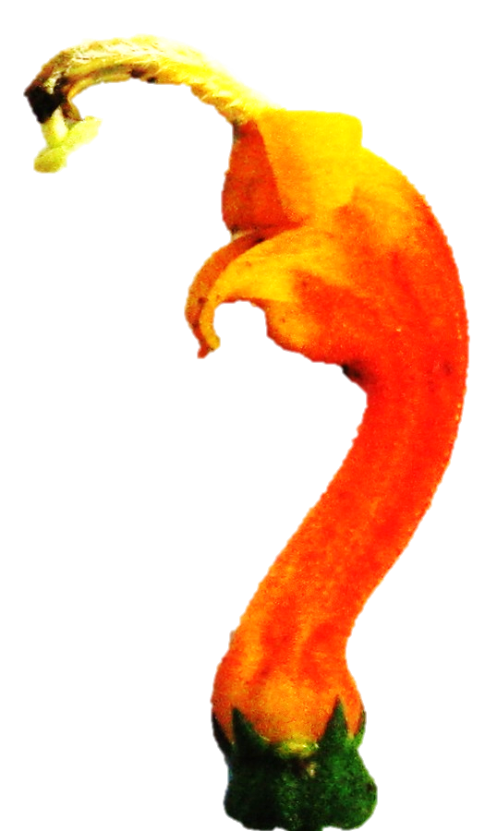
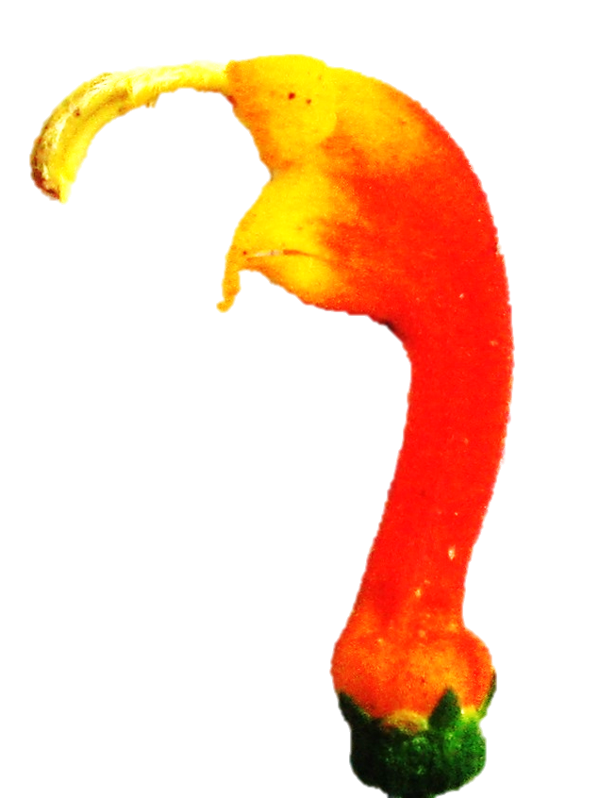
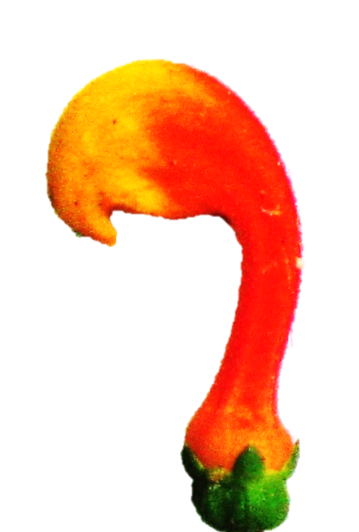
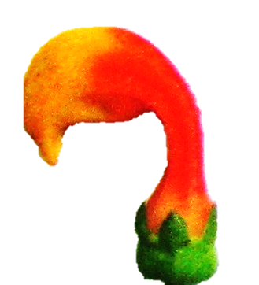
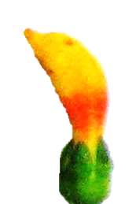
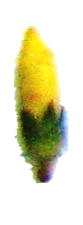
Hummingbirds excluded
Control
10 mm
70
Estimated elapsed days
50
30
A
B
C
D
E
F
G
H
Developmental Stage

Slide 4
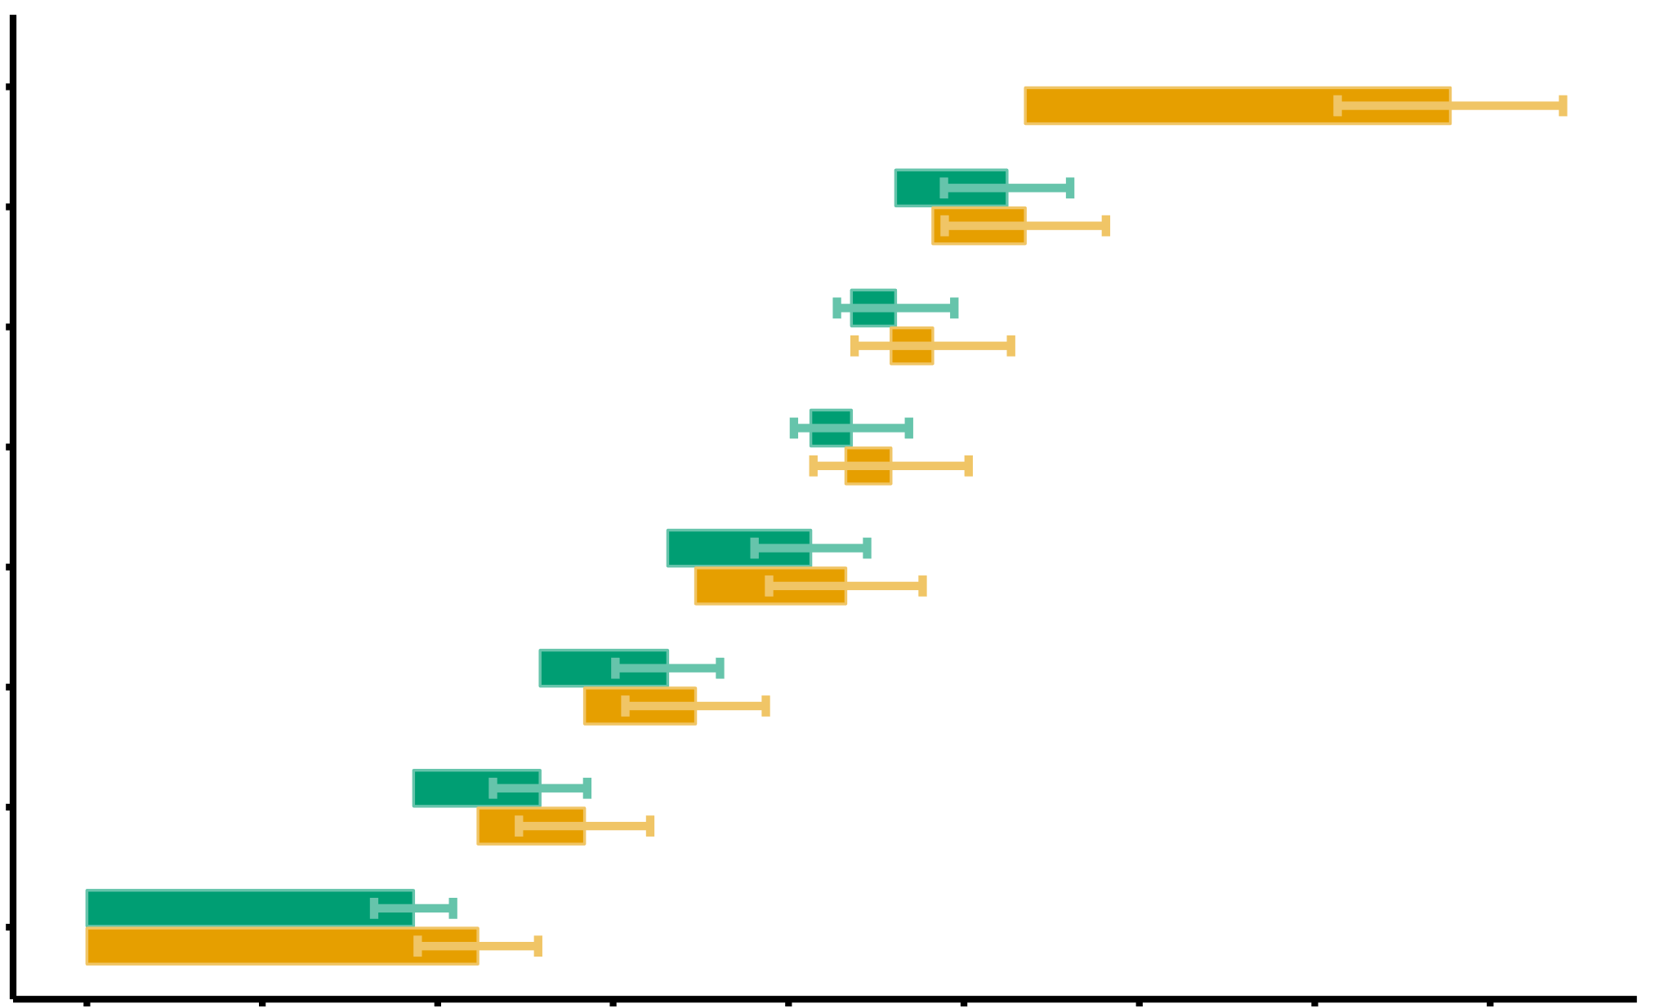
fruit
H
Hummingbirds excluded
Control
G
10 mm
F
E
♀
Developmental Stage
♂
D
C
B
A
0
10
20
30
40
50
60
70
80
Elapsed days

Slide 5
Hummingbirds excluded
Control
15
10
Number of flowers produced
5
0
0
10
20
30
Time (days)

